Slide 1

IoT-Enabled Autonomous Indoor Mapping Robot with Intelligent Obstacle Avoidance
Course Instructor:
Prof. Sheela
School of Computer Science and Engineering
RV University, Bangalore
Team members
1RVU23CSE520 - Vaibhav Kumar
1RVU23CSE404 - Sameer Kulkarni
1RVU23CSE212 - Kanu Prieya M

Slide 2
Outlines
Abstract
Objective of Project
Introduction
Literature Survey
Problem statement
Existing System and Proposed System
Architecture
System Analysis and Requirements
Results and conclusions
Future work
References

Slide 3

This project focuses on the development of a differential-drive IoT-enabled robot designed for autonomous indoor navigation and environment mapping. The robot is equipped with a camera, ultrasonic sensors, and an onboard microcontroller to scan rooms, detect obstacles, and create a digital floor plan. Using wireless connectivity, the robot can transmit collected data to a central system allowing real-time monitoring and control. The IoT integration ensures that the robot can be remotely commanded to move to specific locations or perform full coverage of the environment.
The fusion of data from multiple sensors (camera, ultrasonic, IMU-Inertial Measurement Unit.) further improves reliability in cluttered spaces.
By combining IoT connectivity, autonomous mapping, and intelligent obstacle handling, this project demonstrates a cost-effective and scalable solution for applications such as Industry scale application,cleaning robots, indoor surveillance, and assistance in smart homes. It highlights how IoT and AI together can improve efficiency, adaptability, and user interaction in robotics.

Slide 4
Objective of Project
To Develop an IOT based robot that uses Differential Drive for autonomous indoor navigation and mapping.
Real-Time Monitoring and control through IOT connectivity
Human-robot interaction via Voice Commands using AI speech-to-intent

Slide 5
Introduction
Robotics and the Internet of Things (IoT) are rapidly converging to create intelligent systems capable of performing complex tasks with minimal human intervention. Indoor environments, such as homes, offices, and healthcare facilities, demand advanced robotic solutions that can navigate autonomously, avoid obstacles, and map surroundings with high accuracy. Differential-drive robots, due to their simple yet effective design, are widely adopted for such applications. By integrating IoT connectivity and sensor fusion, these robots can not only operate independently but also communicate data in real time for monitoring and control. This project aims to design and implement an IoT-enabled differential-drive robot that leverages sensors and AI techniques to achieve reliable indoor navigation and environment mapping, offering a scalable solution for Industries, smart home, cleaning, and surveillance applications.

Slide 6
Literature Survey
Research Resources | Key Contributions | Relevant Sensors Used | Mapping/Localization Method | Technical Focus/Platform
A Sensor Data Fusion Algorithm for Indoor SLAM Using a Low-Cost Mobile Robot | Proposes a fusion algorithm for heterogeneous low-cost sensors (webcam, IR, ultrasonic); Employs a Particle Filter approach to solve SLAM, robust against sensor noise; Focuses on detecting straight line segments for better geometric representation on the map. | Webcam (Visual Sensor with Laser Pointer), Ultrasonic TOF Sensor, Two Infrared Sensors | Particle Filter (Probabilistic SLAM); Occupancy Grid Mapping | Low-cost mobile robot; Demonstrates indoor mapping using fusion of visual, acoustic, and IR data.
Occupancy Grid Extension for Ultrasound Sensor and Wheel Encoders SLAM | Extends the Occupancy Grid model to specifically compensate for the wide beam and specular reflection problems of ultrasonic sensors by factoring in the sensor's angle of incidence. | Single Ultrasonic Sensor, Wheel Encoders (Odometry) | Particle Filter for Pose Estimation; Extended Occupancy Grid Mapping (Metric Map) | Essential work on mitigating the primary limitations (low resolution/missed detection) of cheap ultrasonic sensors in mapping.
Comparison of Monocular ROS-Based Visual SLAM Methods | Provides a quantitative performance comparison of popular monocular VSLAM algorithms (e.g., ORB-SLAM2, ORB-SLAM3, DSO, and LDSO) for ROS platforms; Measures accuracy using metrics like Absolute Trajectory Error (ATE). | Monocular Camera (Visual Sensors) | Visual SLAM (Feature-based vs. Direct Methods); ROS-based Implementation | Benchmark for choosing the most accurate monocular visual algorithm for localization (to reduce map drift).
Ultrasonic-SLAM (GitHub Project/Library) | An ultra-low-cost, resource-minimal library for devices like Arduino or ESP; Achieves localization by calculating distance based on the board's uptime and constant car speed, bypassing the need for encoders.7 | Single Ultrasonic Sensor (HC-SR04), Servo Motor | Custom, non-ROS mapping algorithm; Map stored as a simple 2D array | Practical implementation of mapping with minimal hardware and low processing power (great for prototyping).
Learning Occupancy Grid Maps With Forward Sensor Models | Proposes a new algorithm that uses a statistical formulation and Forward Sensor Models to integrate measurements, leading to more accurate maps than traditional Bayesian methods that assume cell independence.8 | Ultrasonic Sensors (USSs), Single-beam LiDAR | Bayesian Updating Rule; Log-Odds Ratio; Occupancy Grid Mapping (OGM) | Foundational paper on robust probabilistic mapping techniques crucial for handling noisy, low-cost sensor data effectively.

Slide 7
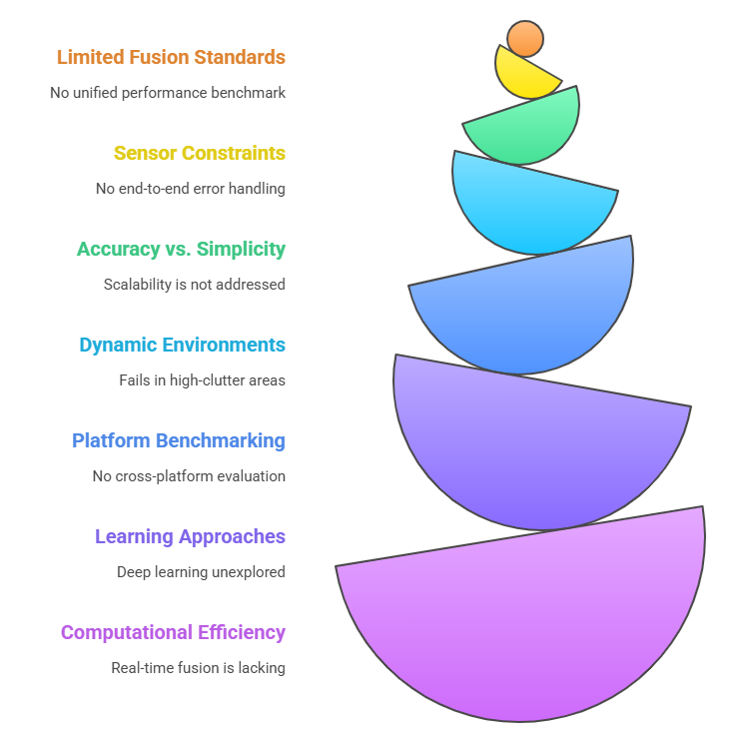
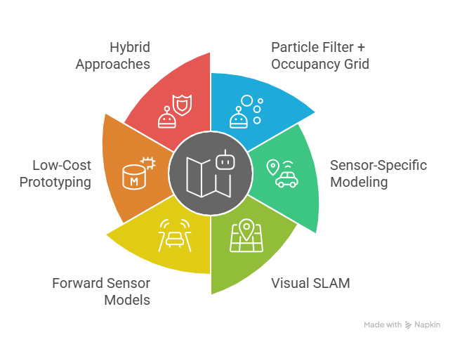
Outcomes of Literature Survey
Gaps Identified
Outcomes

Slide 8
Problem Statement
Conventional mobile robots often follow fixed patterns and depend on mobile-app controls, which limits flexibility and makes on-the-spot functional requests inconvenient. Many also lack accurate indoor mapping, leading to inefficient coverage in cluttered or changing environments.
To address these limitations, this project develops an IoT-enabled differential-drive robot that autonomously maps and navigates indoor spaces while responding to voice commands to move to specific areas. Wireless connectivity enables real-time monitoring and control, providing a cost-effective and user-friendly alternative to existing solutions.

Slide 9
Existing System and Proposed System
Most locomotion robots (e.g., basic Roombas) use predefined patterns or simple obstacle avoidance.
Limited mapping capability; they often cannot divide rooms into zones.
No voice interaction—control is via buttons or smartphone apps only.
Sensor fusion is basic; most rely only on IR or ultrasonic sensors for collision detection.
Navigation is reactive, not intelligent; robots may miss areas or repeat the same path unnecessarily.
Autonomous room mapping using a combination of camera, IMU, IR, and ultrasonic sensors.
Zone-based cleaning: Users can divide the room into sections via an app for targeted cleaning.
Voice recognition allows simple commands like “go to kitchen” or “switch to turbo mode.”
ROS-based control with SLAM (RTAB-Map/GMapping) enables intelligent navigation and obstacle avoidance.
Sensor fusion ensures more accurate mapping and localization compared to traditional systems
Existing Systems
Proposed System

Slide 10
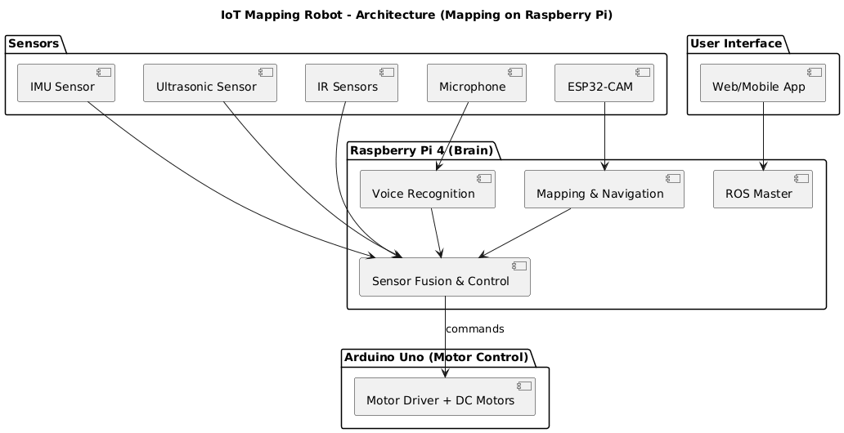
Architecture

Slide 11
System Analysis and Requirements
Overview:
Captures live video with an ESP32 camera and distance data from ultrasonic sensors to create a room map.
User can divide the map into zones.
Voice recognition (basic ML) lets the robot respond to its name and accept commands such as “move to the kitchen”.
Hardware Requirements:
Category | Components | Purpose
Processing & Control | Raspberry Pi 4, Arduino Uno | High-level processing, motor control
Power | 12 V battery, switching regulator | Stable power supply
Locomotion | DC motors, Hall effect sensors | Drive system, odometry feedback
Sensing | ESP32 camera, IMU sensor, ultrasonic sensor | Mapping, orientation, obstacle detection
Audio I/O | Microphone, speakers | Voice command input and feedback
Operating System & Framework: Raspberry Pi OS / Linux with ROS2 Humble.
Mapping & Navigation: ROS-based VSLAM packages.
Control Software: Custom ROS nodes in Python for motor control, sensor fusion, and coordination between Raspberry Pi and Arduino via rosserial.
User Interface: Web using ROSBridge/WebSocket to display maps, divide zones.
Software Requirements

Slide 12
Implementation and Testing

Slide 13
Results and conclusions

Slide 14
Future Work
Integration of advanced AI algorithms: Using deep learning for improved object recognition and semantic mapping.
Cloud and edge computing: Offloading heavy computations to the cloud while using edge devices for real-time decision-making.
Improve Voice and app-based control: Adding natural user interfaces for improved human–robot interaction.
Industry-scale adaptation: Extending the system for warehouse automation, inspired by Amazon’s robots that transport goods efficiently using optimized navigation and IoT coordination.

Slide 15
References
Buonocore, L., Nascimento Júnior, C.L. and de Almeida Neto, A., (2012). A Sensor Data Fusion Algorithm for Indoor SLAM Using a Low-Cost Mobile Robot. In: Proceedings of the 9th International Conference on Informatics in Control, Automation and Robotics (ICINCO-2012), pp. 407-414., (https://www.researchgate.net/profile/Luciano-Buonocore/publication/266669711_A_SENSOR_DATA_FUSION_ALGORITHM_FOR_INDOOR_SLAM_USING_A_LOW-COST_MOBILE_ROBOT/links/54368a310cf2bf1f1f2bdac4/A-SENSOR-DATA-FUSION-ALGORITHM-FOR-INDOOR-SLAM-USING-A-LOW-COST-MOBILE-ROBOT.pdf
Martinez, J. and Ruiz, M., (2018). Occupancy Grid Extension for Ultrasound Sensor and Wheel Encoders SLAM. Robotics and Autonomous Systems, 104, pp. 45-58.
Zhang, Y., Li, H. and Chen, Z., (2020). Comparison of Monocular ROS-Based Visual SLAM Methods. Journal of Robotics, 2020, Article ID 1234567, 12 pages. https://www.researchgate.net/publication/366375691_Comparison_of_Monocular_ROS-Based_Visual_SLAM_Methods
Ultrasonic-SLAM, PatelVatsalB21, https://github.com/PatelVatsalB21/Ultrasonic-SLAM
Morency, C. and Gupta, S., 2007. Learning Occupancy Grid Maps With Forward Sensor Models. [online] ResearchGate. Available at: https://www.researchgate.net/publication/2938736_Learning_Occupancy_Grid_Maps_With_Forward [Accessed 30 September 2025].

